Slide 1
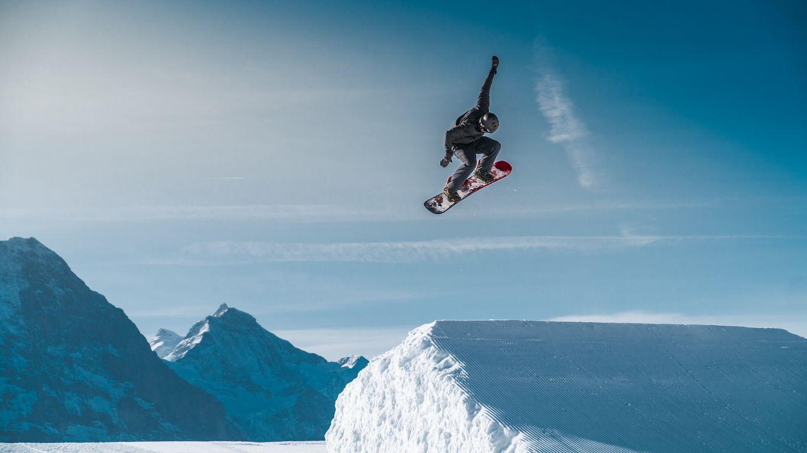
Rental Ski Shop
Eric, Liam & Pleasure

Slide 2

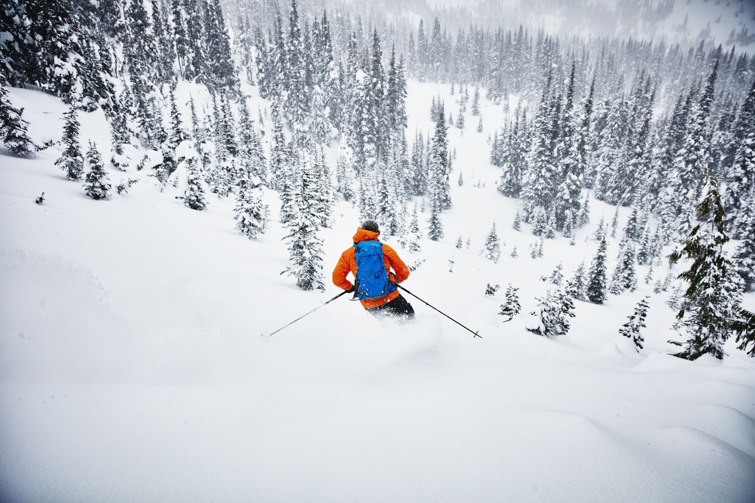
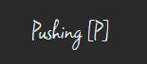
Motivation for Site
Slide created by Pleasure and presented by Pleasure

Slide 3
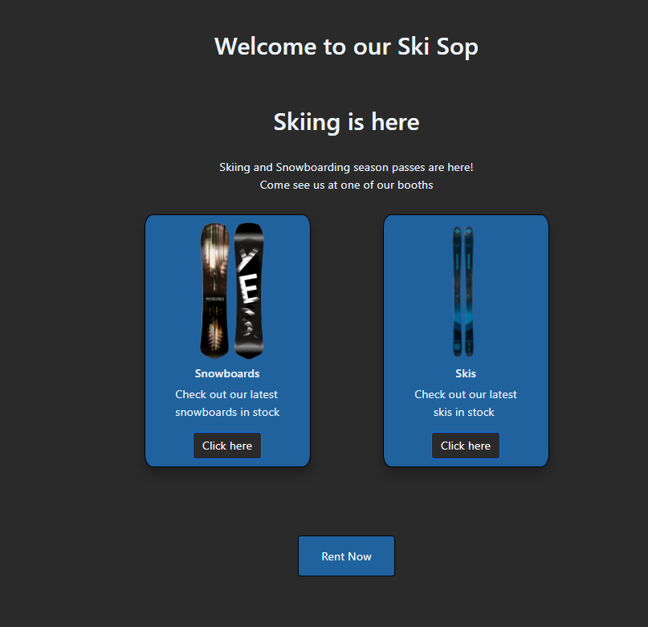
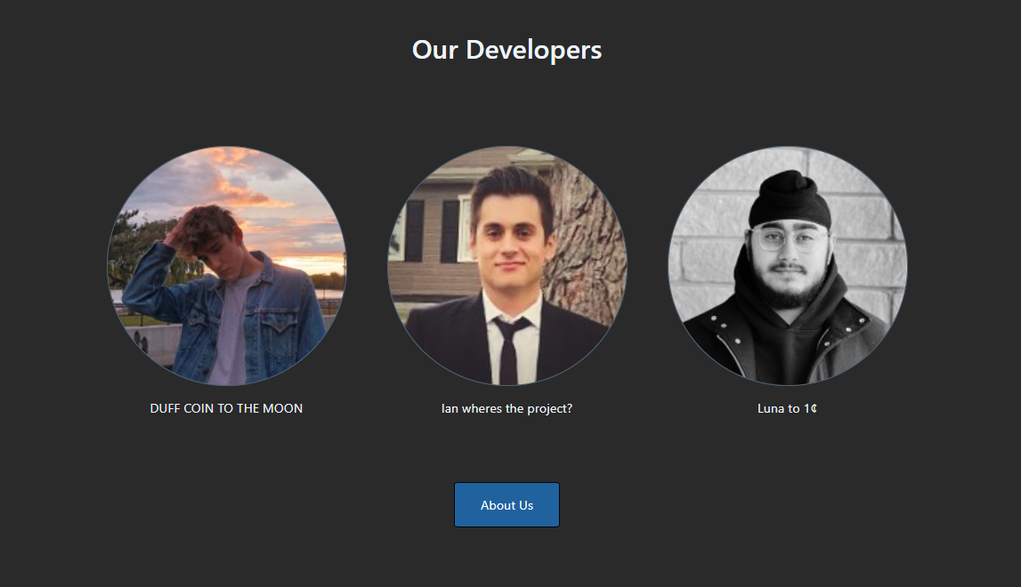
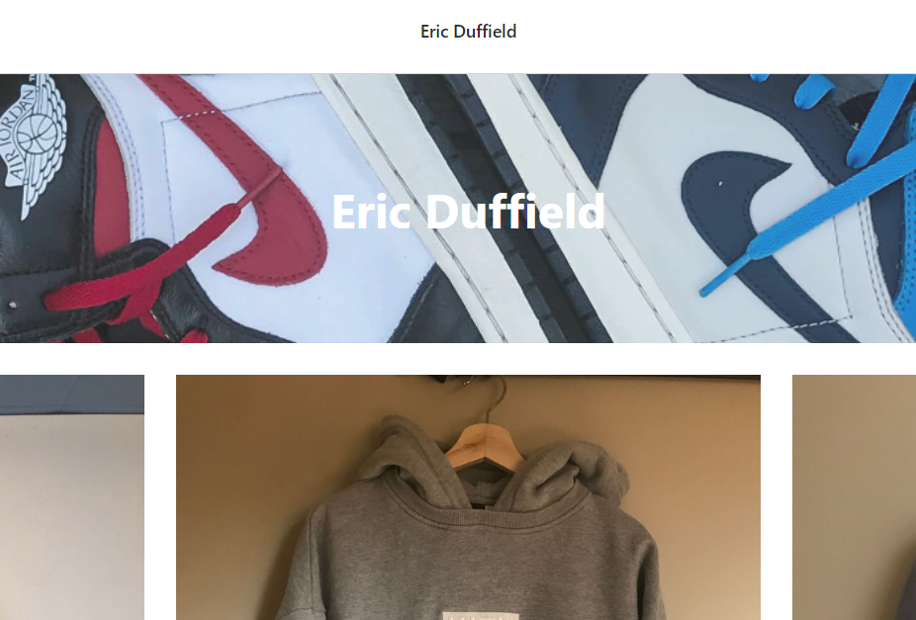
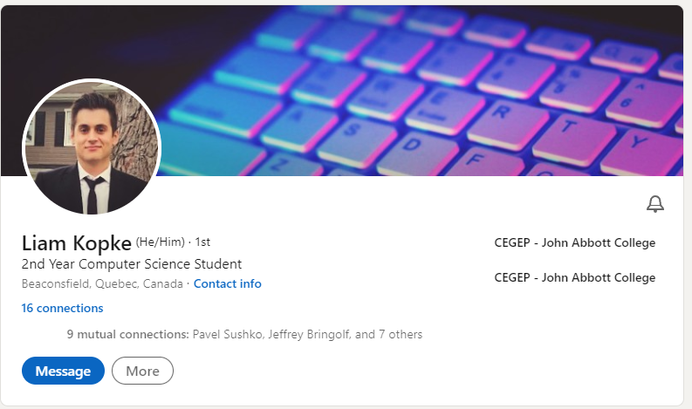
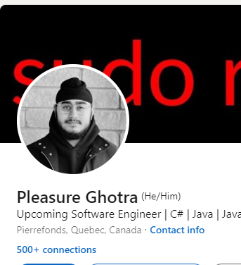
Summary of UI
Slide created by Pleasure and presented by Pleasure

Slide 4
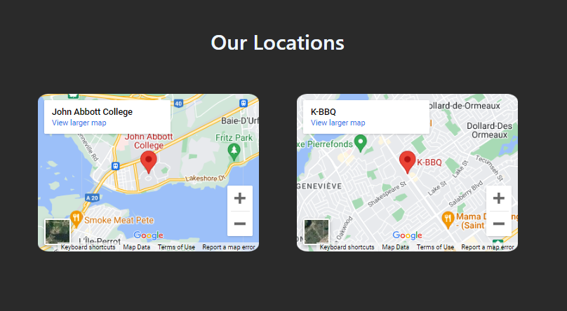
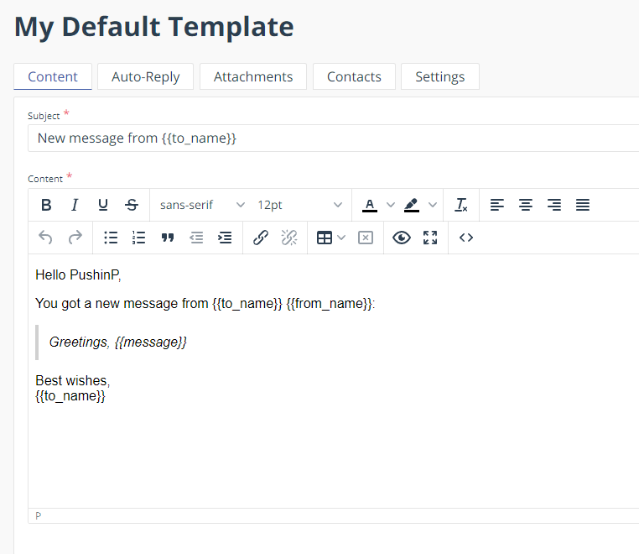
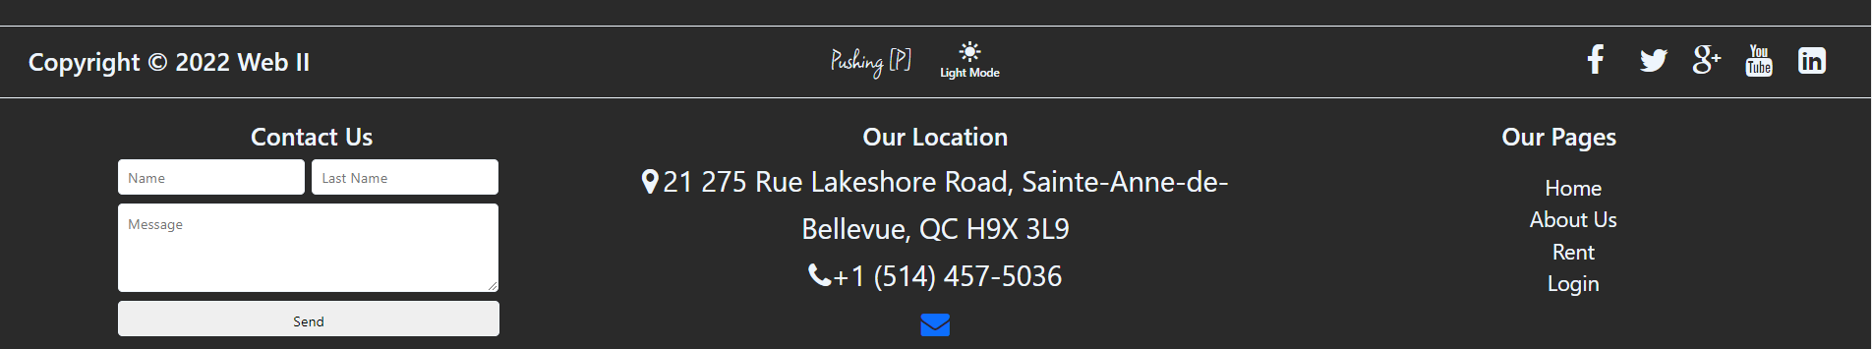
Summary of UI
Slide created by Pleasure and presented by Pleasure

Slide 5
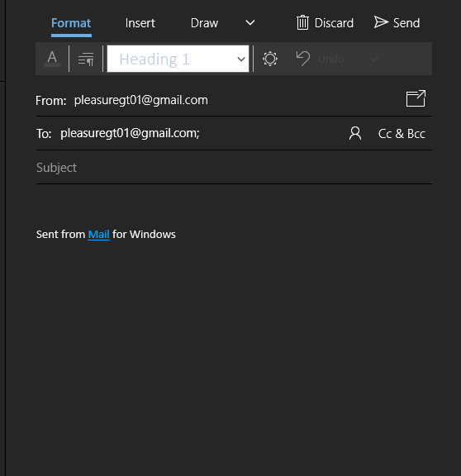
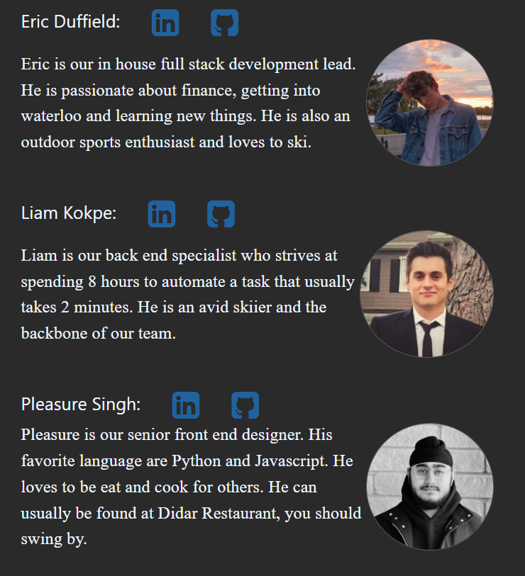
Summary of UI features
Slide created by Pleasure and presented by Pleasure

Slide 6
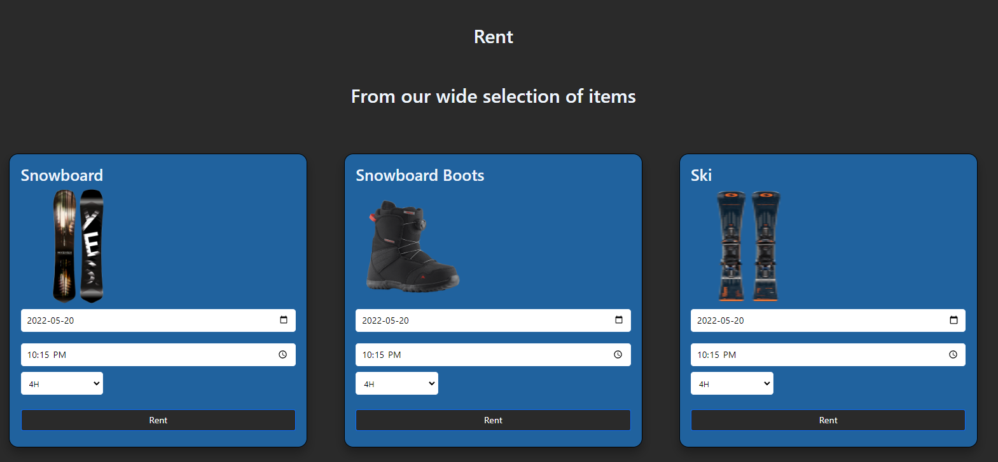
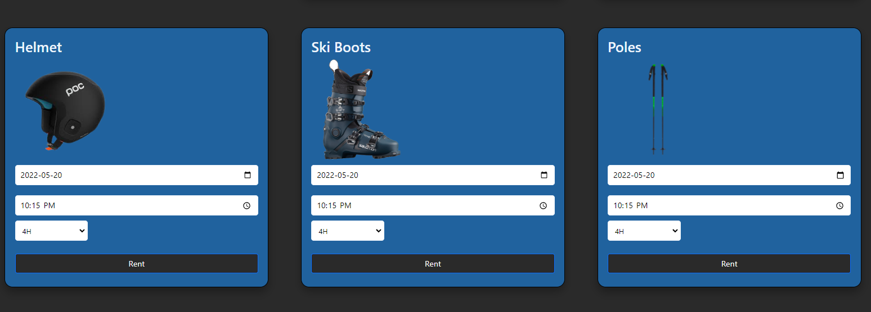
Summary of UI features
Slide created by Pleasure and presented by Pleasure

Slide 7
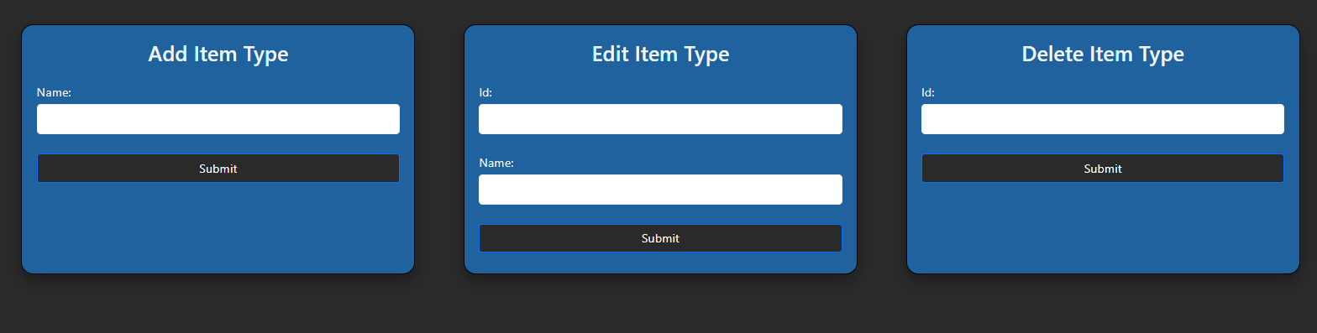
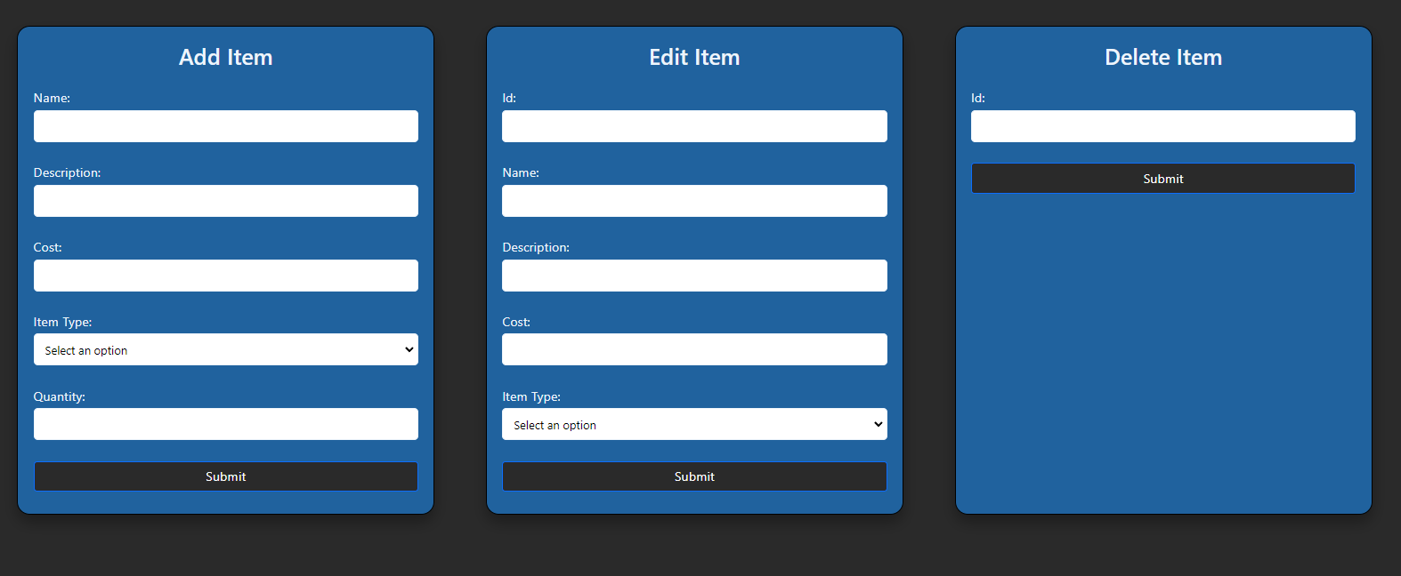
Summary of key admin features
Slide created by Eric and presented by Eric

Slide 8
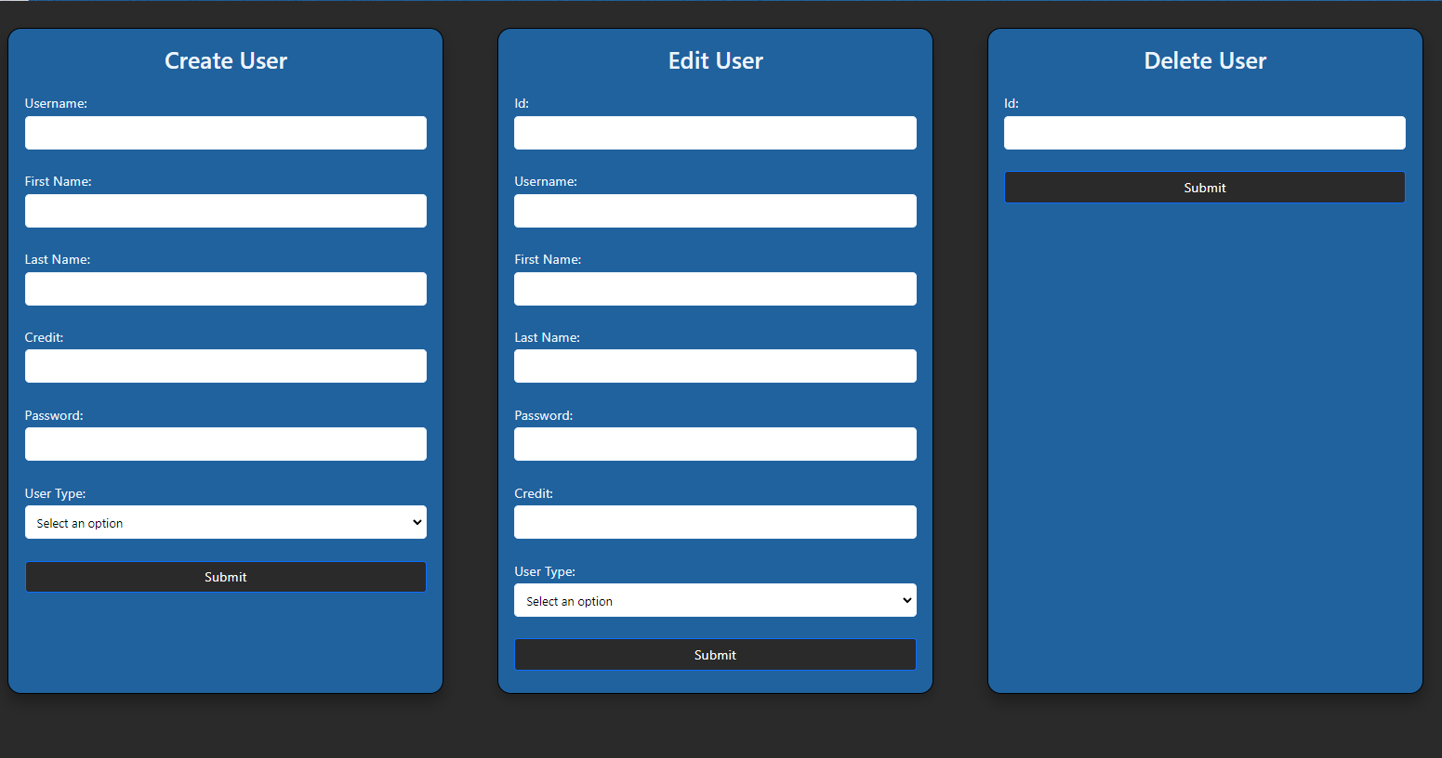
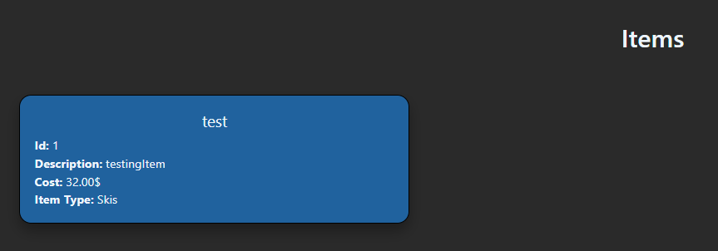
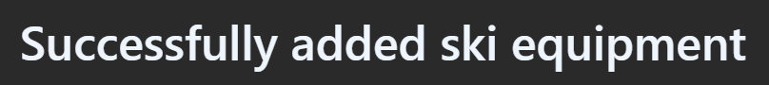
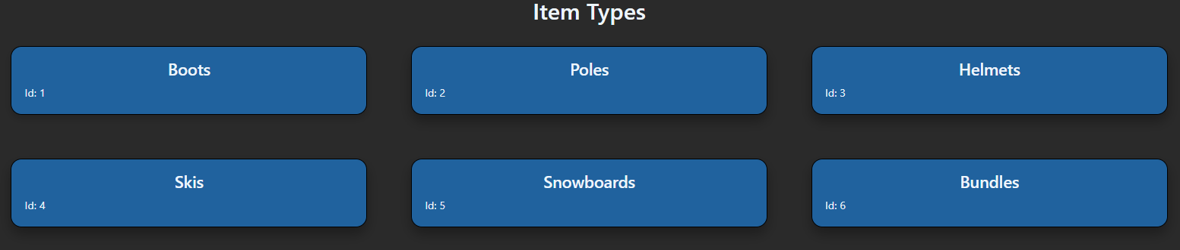

Summary of key admin features
Slide created by Eric and presented by Eric

Slide 9
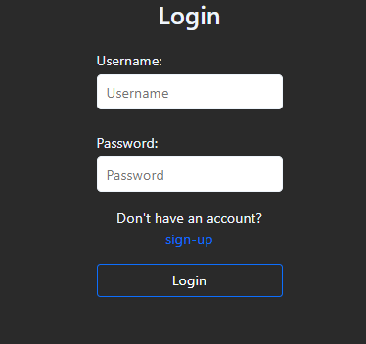
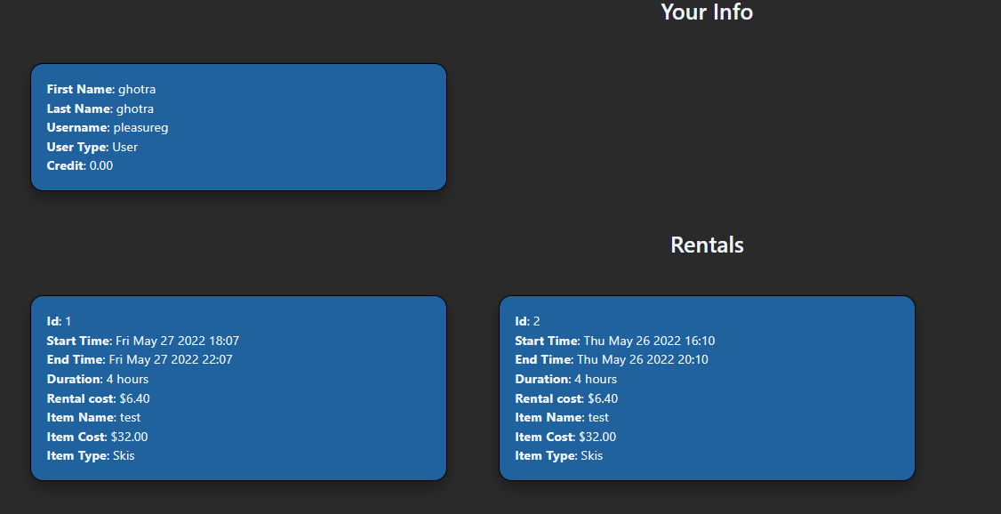
Summary of other key features
Slide created by Eric and presented by Eric

Slide 10
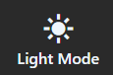
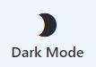
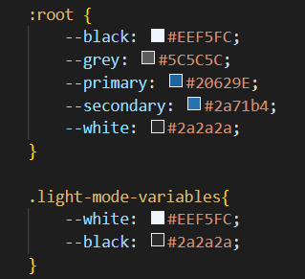
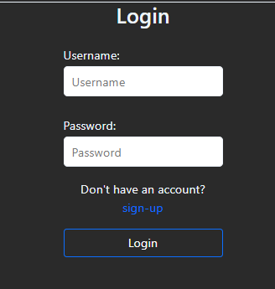
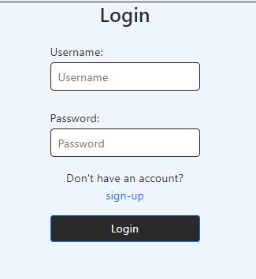
Personalisation: Dark Mode
Colour Variables
Slide created by Eric and presented by Eric

Slide 11
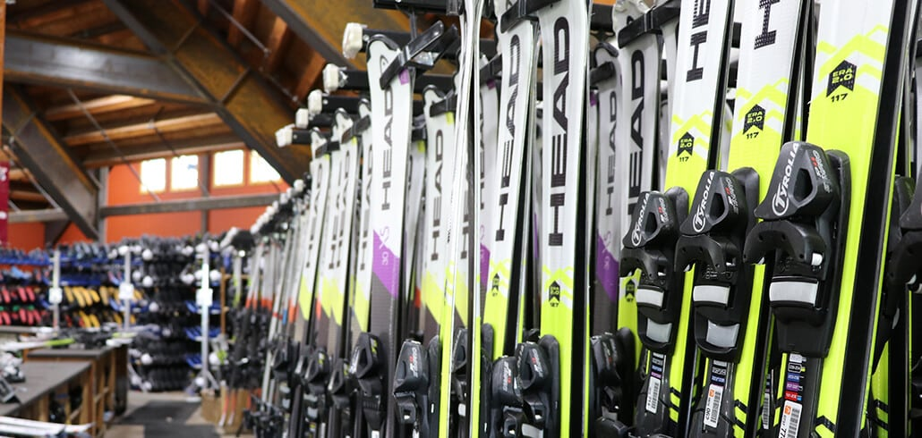

Tracking: User decision
Slide created by Pleasure and presented by Pleasure

Slide 12


Authentication:
Slide created by Liam and presented by Liam

Slide 13
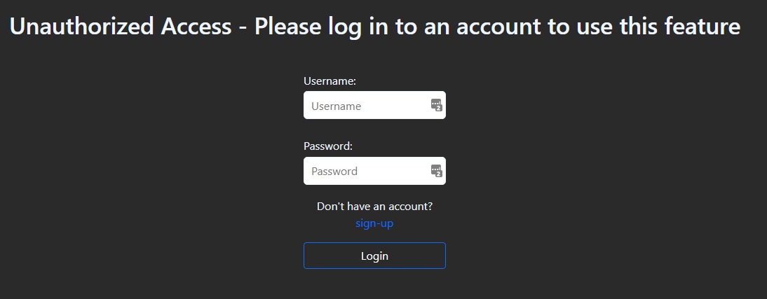
Authentication:
Slide created by Liam and presented by Liam

Slide 14
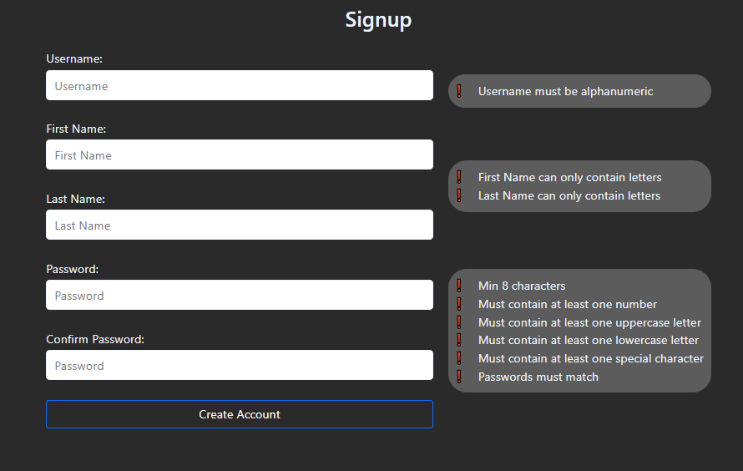
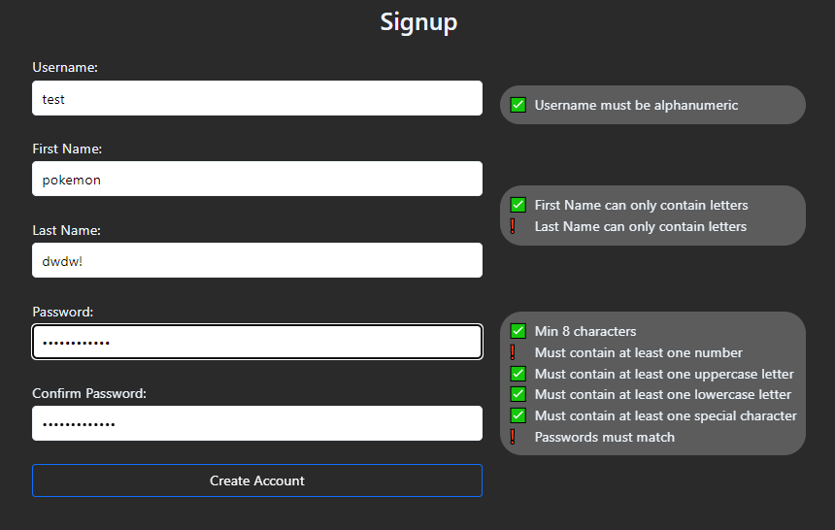
Authentication:
Slide created by Pleasure and presented by Liam

Slide 15
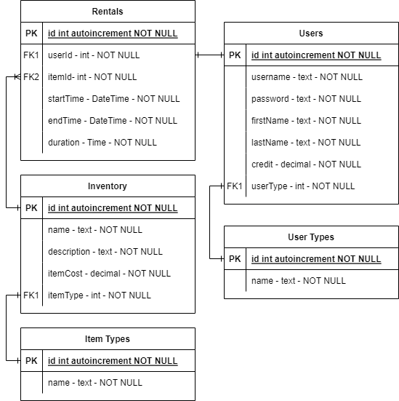

Database design
Slide created by Liam and presented by Liam

Slide 16

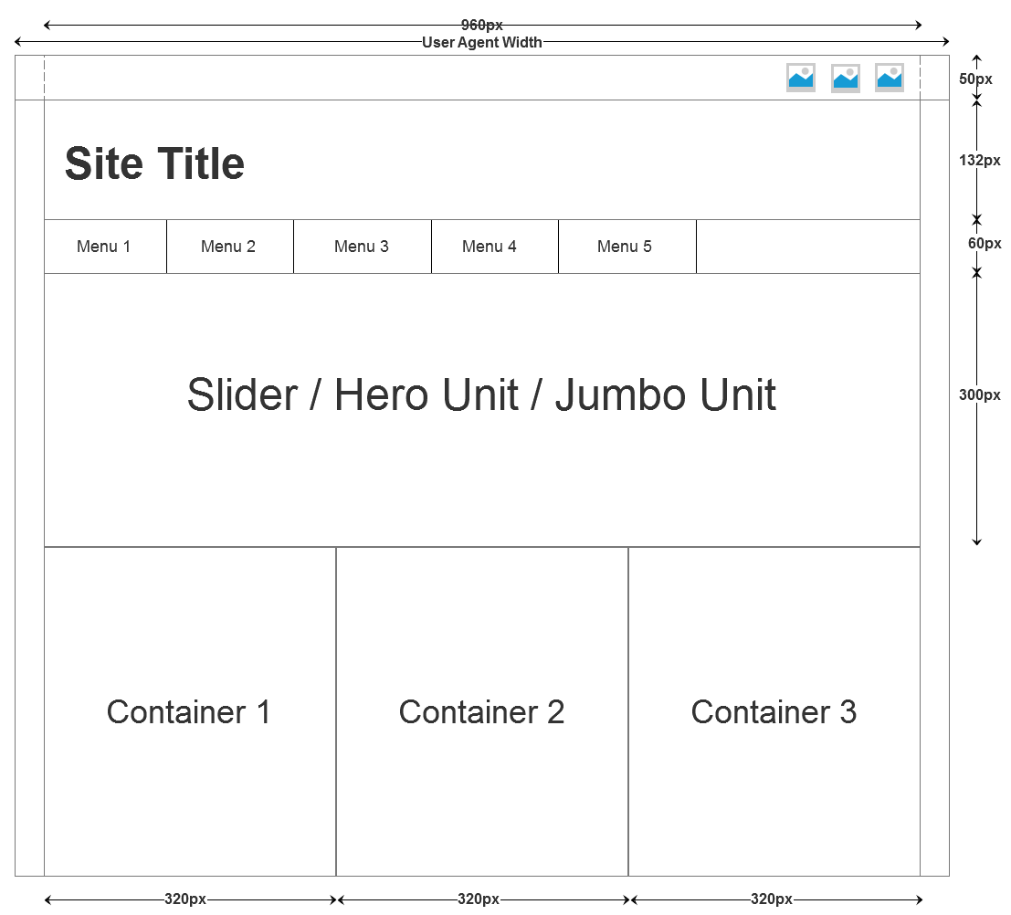

Project Status: Altered Plan
Week 1 - Week 2 - Week3
Slide created by Liam and presented by Liam

Slide 17
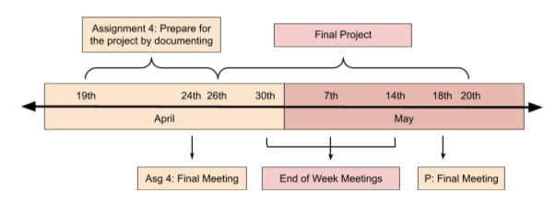
Project Status: Original Timeline
Slide created by Pleasure and presented by Pleasure

Slide 18
Task List Comparison
30th | 7th | 14th | 19th
Finish Skeleton | Finish Admin SQL | Finish Rental SQL | Add the details
Fill out skeleton | Start Front End | Add Cookies | Write texts
Add all the pages | Finish Admin feats. | Finish Rental feats. | Finish Tests
Slide created by Liam and presented by Pleasure

Slide 19



Issues Encountered
Slide created by Eric and presented by Eric

Slide 20
Next Steps

